Slide 1
Requirements Gathering and Analysis with
Use Cases
Lecture Use Case Modelling
Version 3

Slide 2
Introduction to Requirements Analysis
Requirements require to be collected from the stakeholders
  that reflect accurately the needs of the system to be developed.
This can be best accomplished in an iterative manner.
The first set of requirements are often general in nature as the exact details have yet to be determined.
Using an iterative approach the requirements can be identified and then analysed,
  In order to determine more complete or new requirements.

Slide 3
Introduction to Requirements Analysis
Analysing requirements can be accomplished using many techniques and analysis models.
The proposed approach is Use Case modelling and Analysis.
This is a well-developed techniques that is widely accepted as an industry standard for Analysis and Design in Object Oriented software development.

Slide 4
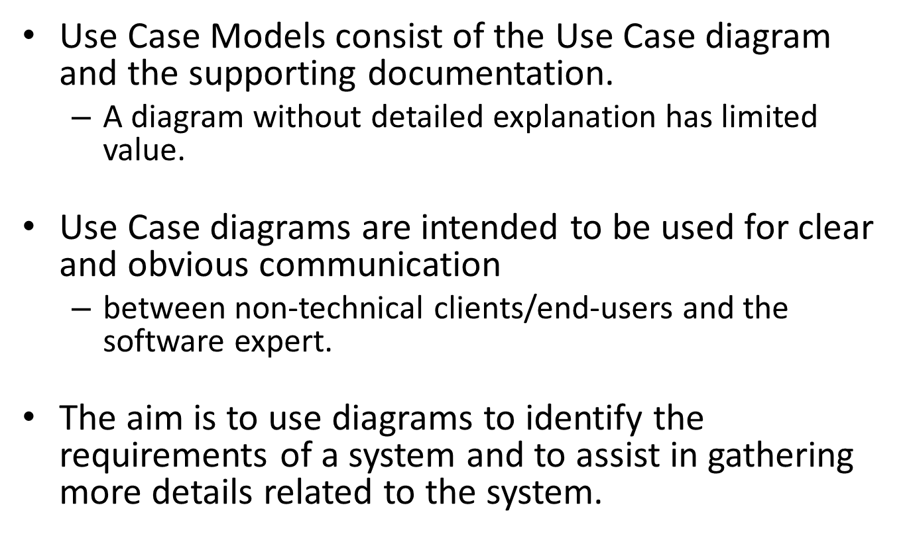
Use Case Modelling

Slide 5
Automated Library System
First Iteration
1. Using the Library System
1. Using an Automated Library system
Student
Automated Library System

Slide 6
Use Case Modelling
Use Case analysis will also identify additional requirements. These can then be added to the Use Case model.
This will be done in an incremental and iterative manner.
The iterations continue until sufficient requirements have been identified.

Slide 7
Use Case Model Purpose
The Use Case Model will be used to ensure:
  all requirements have been gathered
  and analysed
to be certain
  the system under development will be actually what the client needs.
  (The client may want one system but actually need a different system to do what they say they need.)

Slide 8
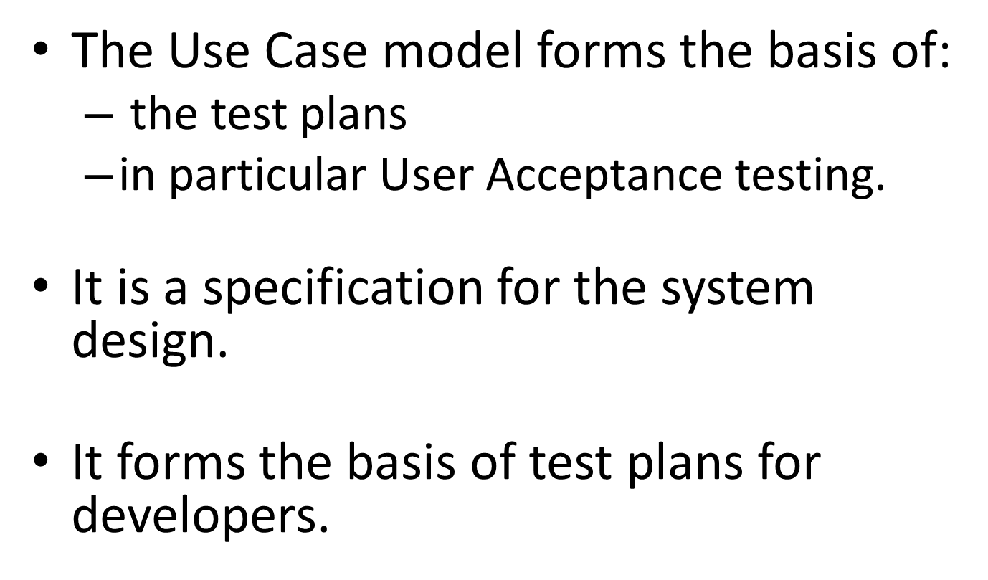
Use Case Model Purpose

Slide 9
Use Case Model Purpose
The main purpose for the Use Case model is as the basis for the contract between client and developer.
It is the basis for the user Acceptance testing at product delivery time. (payment time)

Slide 10
Use Case Analysis
Use Case analysis require to be carried out in different stages.
An iterative approach is required to be used for all requirements analysis.
The client/end-users and the Analysts will identify additional system requirements as the process of specifying a system is followed.
A single stage for gathering requirements will not allow the opportunity for analysis and refinement of the system specification.

Slide 11
Use Case Iterations
The number of iterations required to create the system specifications will depend on the size and complexity of the system.
For a large system it is essential to break (decompose) the system into identifiable modules for analysis.
Having identified a major activity of a system the use case can be developed.

Slide 12
First Use Case Model
The first iteration of the model may be quite complex, depending on the experience and expertise of the analyst the
However it is always best to start with a very simplified Use Case Model for the client/end-user.
In this approach the first set of Use Case diagram s will be limited to one summary Use Case with detailed supporting documentation.
Recall a Use Case model is made up of the Use Case Diagram and supporting documentation.

Slide 13
Use Case Diagrams
The use case diagram consists of a limited number of elements.
The limitation is to ensure simplicity.
There are some features in Use Cases that may be appropriate for Software Engineers and appropriate for later Design activities.
It is recommended that only simple features are used at the Requirements gathering and analysis phase of the development process.
The key elements are the Actor, the Use Case, the system boundary and the communications connection. (Dependencies can be considered for later design but avoided at requirement Analysis).

Slide 14

Actor
Actor Role/Title
Student
The Actor:
An Actor is something, person or system that is external that can interact with the system.
  Can be a Person or other external system, such as a database.

Slide 15

Use Case
1. Use Case Title
The Use Case:
The use Case is an significant piece of functionality in the system as identified by the initial requirement gathering.

Slide 16
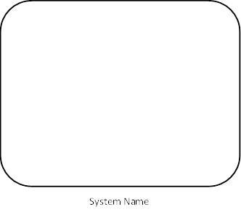
System Boundary
System Name
System Boundary:

Slide 17
Connector
The Communication Connection:
The direction of the arrow depends on who or what starts the interaction in a particular situation or scenario.

Slide 18
Use Case Diagram
The sample Use Case Diagram is for an Automated Library System in a college environment.
The student interacts directly with the system. No Librarian
In this scenario it is the student actor who starts the interaction by requesting to borrow a book.

Slide 19
Automated Library System
First Iteration
1. Using the Library System
1. Using an Automated Library system
Student
Automated Library System

Slide 20
Use Case Documentation
The diagram is useful for describing the interaction between an Actor and a Part of the system.
To properly describe the system a description of the Use Case is required. This is initially a brief set of sentences.
Then it requires the analysis of the requirement in the context it is intended for use.
In the sample above the context is an Actor in a college environment.
The specific situation or scenario is that of borrowing a book.
This Scenario requires to be analysed.

Slide 21
Scenario analysis
By reviewing the description of the requirement it is possible to:
  consider the scenario
  develop a set of simple steps
  to describe the interaction
  between the Actor and The Use Case under consideration.
The scenario analysis is carried out initially considering that there are no problems.
The scenario is a complete success, the “happy path”.

Slide 22
Using Library to Borrow Book
Use Case 1: Using the Library system
Brief Description
  The scenario for Use Case 1 in this iteration, 1, describes all the parts of the process for using the library to borrow a book in simple steps and simple language.
Pre-conditions : Post-conditions: book borrowed
Main flow of Use Case 1: Using Library to Borrow book
1.1 Student …
1.2 ….
1.3….
1.4 ….
1.5 ….
…..
Exception Flows
1.1.1 …
1.1.2 …

Slide 23
Exception flows
Then consider Exception or Error flows that may occur.
Generally consider two or three error flows for each Use Case

Slide 24
Automated Library System
Second Iteration
Identify the highest priority features
  Core system features need to considered first
  Features such as logging on are usually not highest priority
From the Main flow the most important features are identified
These are then used to create a new set of use cases
The core aim of using the library is to borrow a book and receive the book so these two would form a good starting point

Slide 25
Second Iteration
Step1
Borrow book is the main aim of the system
This is ideal as a new use case
1. Borrow Book
Student
Automated Library System

Slide 26
Second Iteration
Step 2 Add the next use case
The next main aim is to give a book to the user
Provide Book as a new use case
1. Borrow Book
Student
2. Book Provided
Automated Library System

Slide 27
Second Iteration
Step 3 Identify other Use Cases
An important consideration is potential income
Books cannot be borrowed if a fine is due.
1. Borrow Book
3. Check Fines Due
Student Database
Student
2. Book Provided
Automated Library System

Slide 28
Second Iteration
Step 4 Identify other Use Cases
Once provided the Library database needs to be updated
1. Borrow Book
3. Check Fines Due
Student Database
Student
2. Book Provided
4. Update Book Record
Library Database
Automated Library System

Slide 29
Second Iteration
Step 5 Scenario Analysis for Use Cases
Starting with Use Case 1: Borrow Book
  The steps required to complete the process require to be identified in the narrative.
  2 Exception flows can be developed for this Use Case
Complete the Narrative for Use Case 2: Book Provided, include 2 error flows
Complete the Narrative for Use Case 3: Fines Due, include 2 error flows
Complete the Narrative for Use Case 4: Update Book Record , include 2 error flows

